Slide 1

Smart Toll Collecting System with Object Detection
AKATSUKI
“To Make collection system easy peasy”

Slide 2




MEET OUR TEAM
SYED MOHIUZZAMAN
PRANAB BARUA ARTHI
AYAT ULLAH
HAIMAN NATH DEW
C201070
C201073
C201050
C201067

Slide 3
GOALS OF PROJECT
To reduce traffic jam around toll collection Booth.
To detect vehicle in toll tax place .
To detect paid or non paid vehicles.
To prevent Corruption
To reduce Operating Cost and time.
Develop a better management system in Toll Booth.

Slide 4
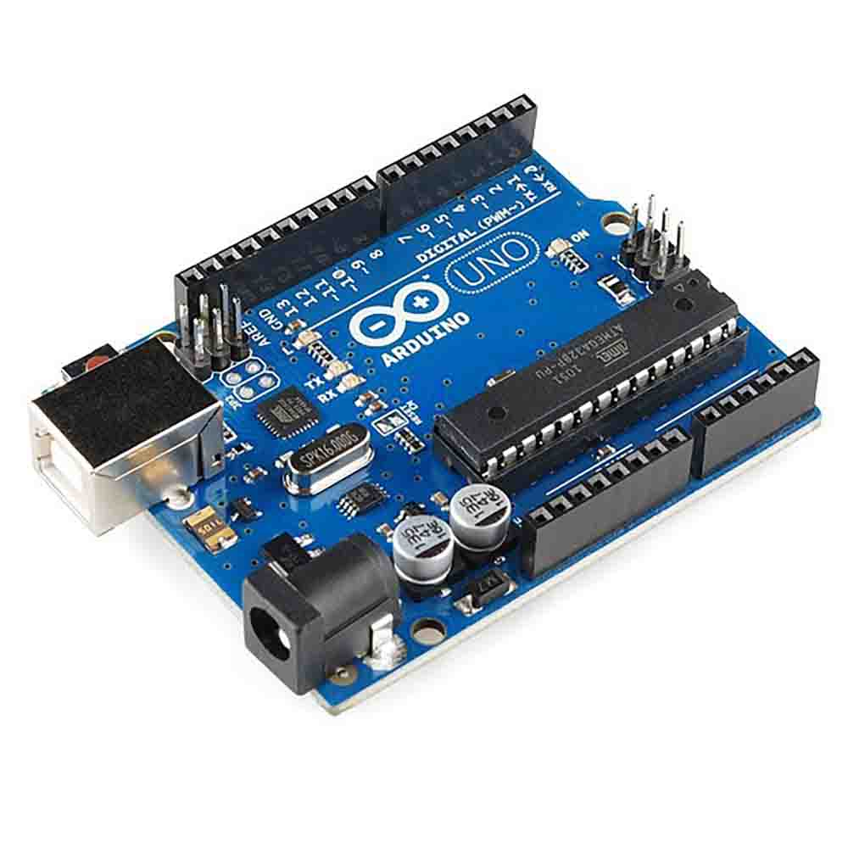
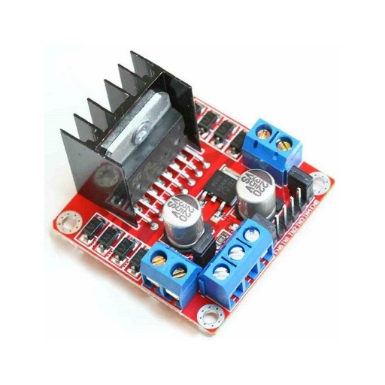
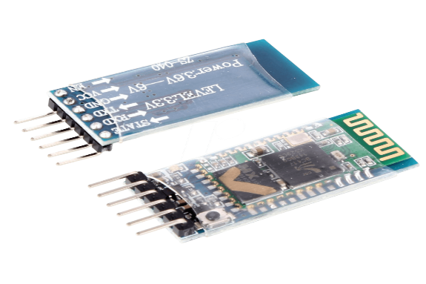
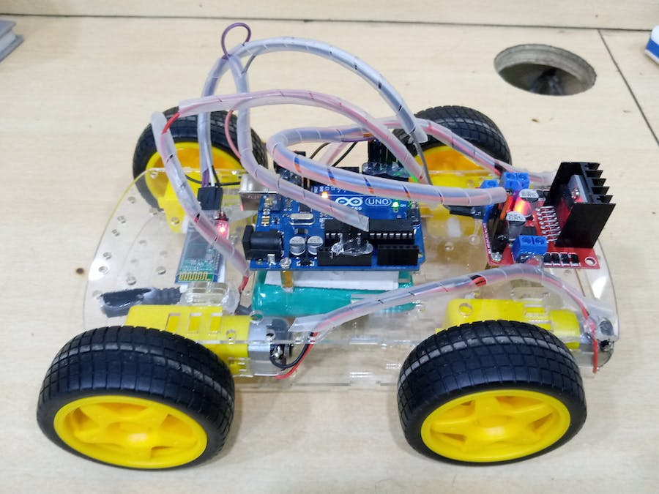
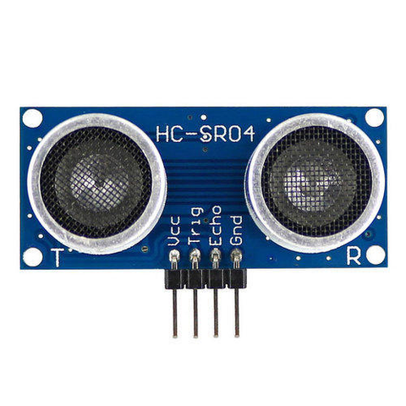
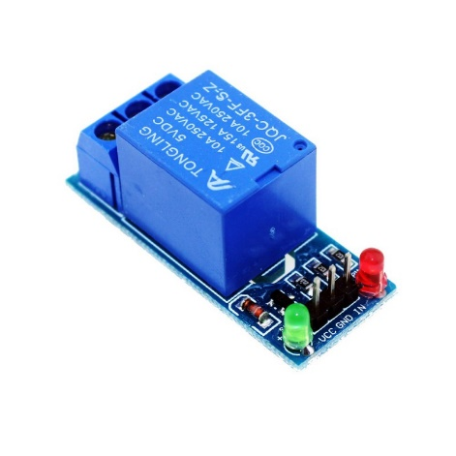
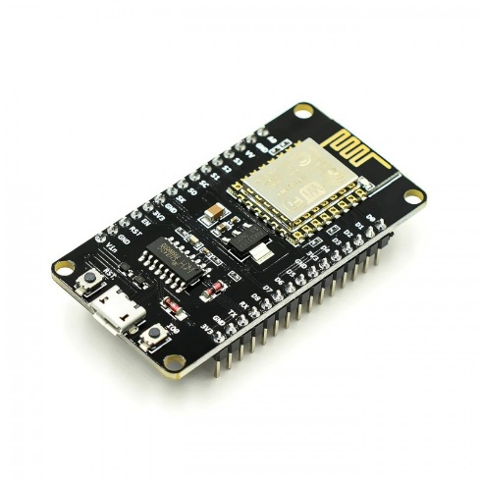
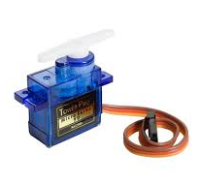
SENSORS & EQUIPMENT
Arduino
Motor Driver
Bluetooth Module
Car Module
Ultra Sonic Sensor
Relay Module
NodeMCU ESP8266
Servo Motor

Slide 5
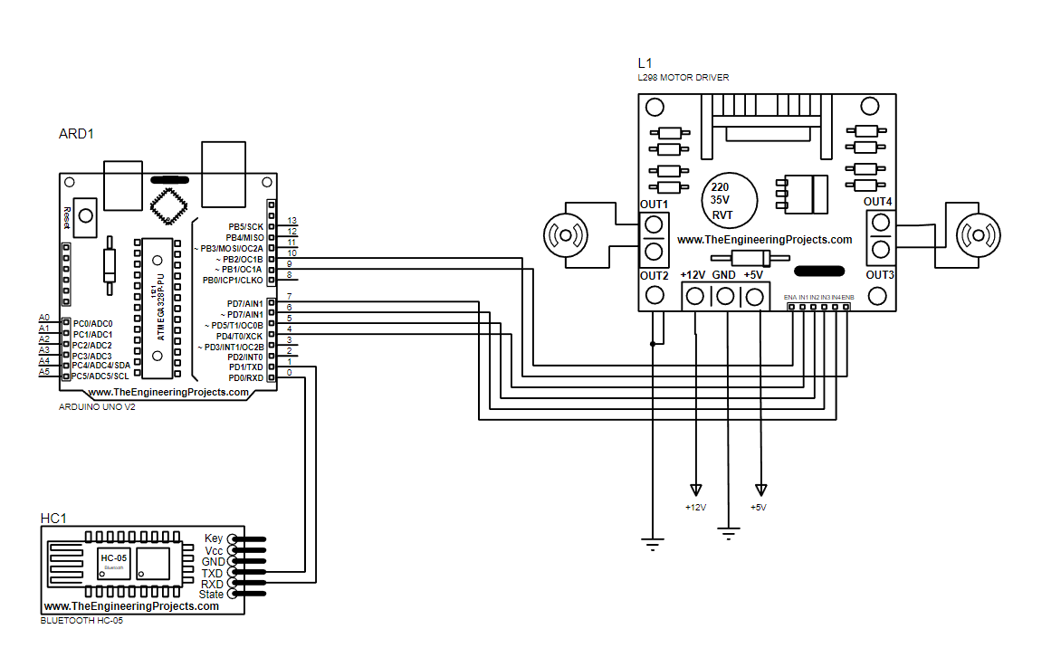
Car Diagram

Slide 6
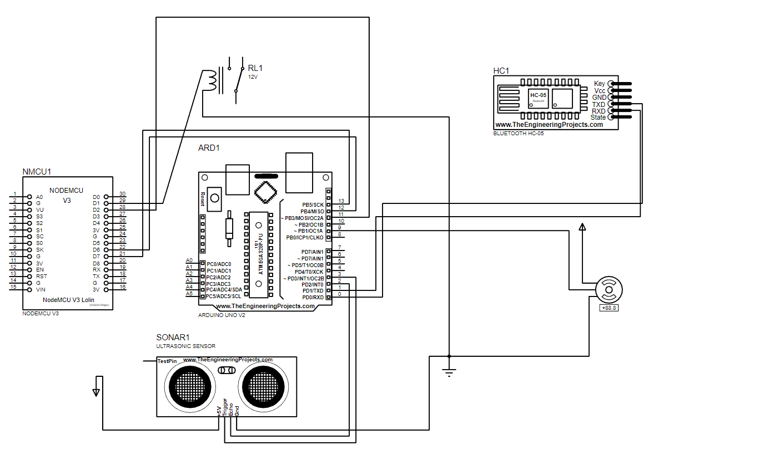
Automatic Tollbar Diagram

Slide 7
WORKFLOW
Controlled Car Transmitter
Receiver Detect Car
Toll Request
Yes
Toll Cross
No
Generate Ticket
End

Slide 8
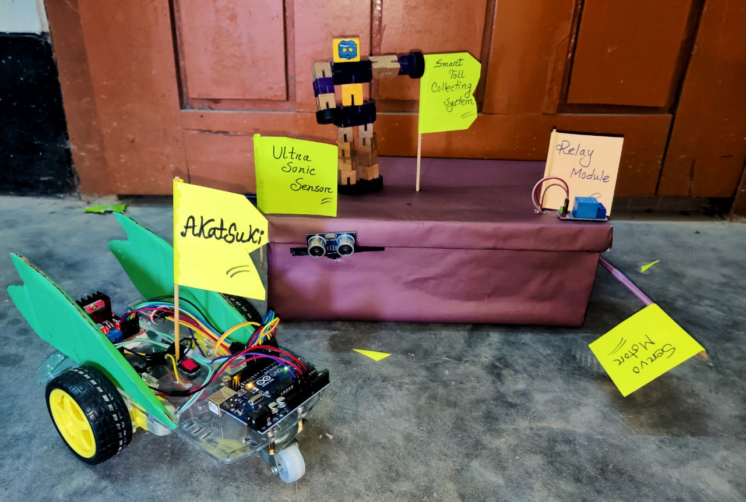
Project Prototype

Slide 9
Detecting logic
1.
Firstly car must be in the selected area of ultrasonic sensor
2.
After getting the car in selected area , the sensor test it 5 times for ensure
3.
Then the time counting will be started for paying amount.
4.
If fail to pay in between estimated time then system will return a token of fine

Slide 10
CONCLUSION
1
We are trying to make a automatic smart Toll collection Booth which will
detect vehichles,Receive a payment from vehicles,Give permission for to
pass the Toll.
2
By this system we can reduce traffic jam
around toll collection Booth, detect vehicle in toll tax place, detect paid
or non paid vehicles,prevent Corruption, Reduce Operating Cost,develop
a better management system in Toll Booth, maintain the time
consumption during Toll collection.

Slide 11
THANK YOU
“War will never cease to exist”

